Slide 1
Module 4 - Advanced features of Java
Multithreaded Programming

Slide 2
Thread
A thread in Java, is the path followed when executing a program.
All Java programs have at least one thread, known as the main thread.
A multithreaded program contains two or more parts that can run concurrently.
Threads are lightweight processes within a process.
Notes:
Using thread we can do multiple activities at the same time.
All Java programs have at least one thread, known as the main thread
— which is created by the Java Virtual Machine (JVM) at the program's start, when the main() method is invoked with the main thread
Multithreaded Programming
Java provides built-in support for multithreaded programming.
A multithreaded program contains two or more parts that can run concurrently.
Each part of such a program is called a thread, and each thread defines a separate path of execution.
Separate memory area is not allocated to threads.
Threads are lightweight processes within a process.
Multithreading is a specialized form of multitasking.
Multithreading maximizes the utilization of CPU

Slide 3
Java Thread Model
All the class libraries are designed with multithreading.
Java uses threads to enable the entire environment to be asynchronous.
This helps to reduce inefficiency by preventing the waste of CPU cycles.
The benefit of Java’s multithreading is that the main loop/polling mechanism is eliminated.
One thread can pause without stopping other parts of your program.
When a thread blocks in a Java program, only the single thread that is blocked pauses. All other threads continue to run.
Notes:
Asynchronous threading means, a thread once start executing a task, can hold it in mid, save the current state and start executing another task.

Slide 4
Thread States in Java
New -thread is born
Runnable-thread is ready to run(start () invoked)
Running –CPU has allocated time slot to thread for its execution.
Blocked (Non-runnable state)- thread is alive, but not eligible to run
Terminated- thread completed its execution
Notes:
Thread
Threads exist in several states.
A thread can be running.
It can be ready to run(runnable) as soon as it gets CPU time.
A running thread can be suspended(blocked), which temporarily suspends its activity.
A suspended thread can then be resumed(runnable), allowing it to pick up where it left off.
A thread can be blocked when waiting for a resource.
At any time, a thread can be terminated, which halts its execution immediately.
Once terminated, a thread cannot be resumed.

Slide 5
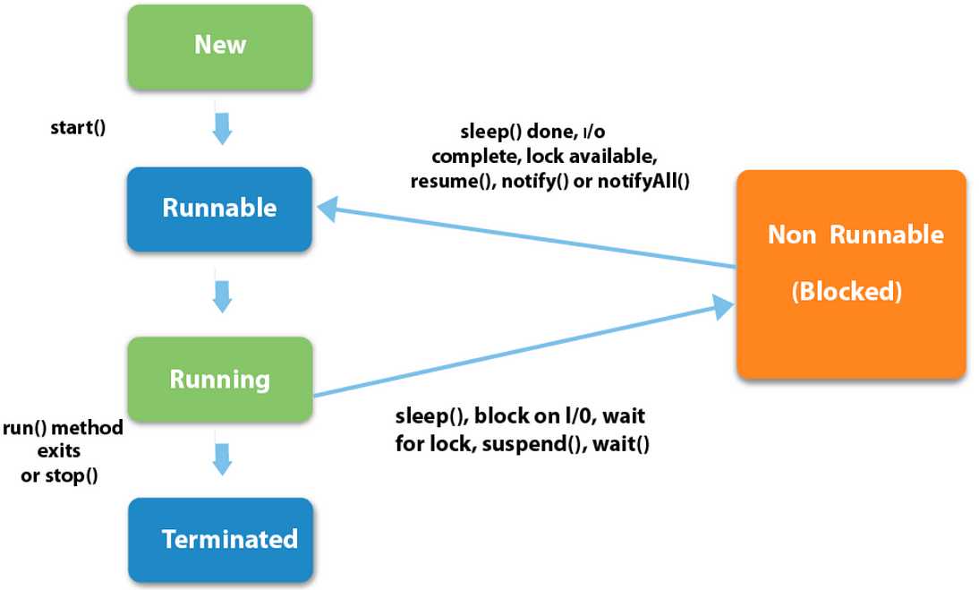

Slide 6
Thread Priorities
Java assigns to each thread a priority that determines how that thread should be treated with respect to the others.
Thread priorities are integers that specify the relative priority of one thread to another.
A thread’s priority is used to decide when to switch from one running thread to the next.
Switching from one thread to another is called a context switch.

Slide 7
The rules that determine when a context switch takes place are:
A thread can voluntarily relinquish control.
A thread can be preempted by a higher-priority thread

Slide 8
The Main Thread
When a Java program starts up, one thread begins running immediately.
This is usually called the main thread of your program, because it is the one that is executed when your program begins.
The main thread is important for two reasons:
It is the thread from which other “child” threads will be spawned.
Often, it must be the last thread to finish execution because it performs various shutdown actions.

Slide 9
Main thread can be controlled through a Thread object by calling currentThread( ) method
Eg:
class CurrentThreadDemo
{
public static void main(String args[])
{
Thread t = Thread.currentThread(); //t is a reference to the main thread
System.out.println("Current thread: " + t);
t.setName("My Thread"); // change the name of the thread
System.out.println("After name change: " + t); //print changed name

Slide 10
try {
for(int n = 5; n > 0; n--) { // loop counts down from 5 pausing 1 sec.
System.out.println(n);
Thread.sleep(1000); // 1000 specifies the delay period in milliseconds
} }
catch (InterruptedException e) {
System.out.println("Main thread interrupted");
} }}
Output
Current thread: Thread[main,5,main]
After name change: Thread[My Thread,5,main]
5
4
3
2
1

Slide 11
Creating a Thread
Java defines two ways for creating a thread :
• implementing the Runnable interface.
• extending the Thread class

Slide 12
Extending Thread
The Thread class provide constructors and methods to create and perform thread operations
The Thread class extends Object class and implements Runnable interface
Commonly used Constructors of Thread class:
Thread()
Thread(String name)
Thread(Runnable r)
Thread(Runnable r, String name)

Slide 13
Thread Methods
Important methods available in the Thread class are
public void run()
used to perform action for a thread.
public void start()
starts the execution of the thread. JVM calls the run() method on the thread.
public void sleep(long milliseconds)
Causes the currently executing thread to sleep (temporarily cease execution) for the specified number of milliseconds.
public void join()
waits for a thread to die.

Slide 14
public int getPriority()
returns the priority of the thread.
public int setPriority(int priority)
changes the priority of the thread.
public String getName()
returns the name of the thread.
public Thread currentThread()
returns the reference of currently executing thread.
public void stop()
used to stop the thread(depricated).
public boolean isDaemon()
tests if the thread is a daemon thread.

Slide 15
start ()
when we call the start() method of our thread class instance, a new thread is created with default name Thread-0 and then run() method is called and everything inside it is executed on the newly created thread.
run ()
when we called the run() method of our MyThread class, no new thread is created and the run() method is executed on the current thread i.e. main thread. Hence, no multi-threading took place. The run() method is called as a normal function call.

Slide 16
class MyThread extends Thread{
public void run(){
System.out.println("Current thread name:"+ Thread.currentThread().getName());
System.out.println ("run method called");
}}
class ThreadClass {
public static void main(String[] args){
MyThread t = new MyThread();
t.start();// create a new thread and it execute run()
}}
Output
Current thread name:Thread-0
run method called

Slide 17
class MyThread extends Thread{
public void run(){
System.out.println("Current thread name:"+ Thread.currentThread().getName());
System.out.println ("run method called");
}}
class ThreadClass1 {
public static void main(String[] args)
{
MyThread t = new MyThread();
t.run();
}}
output
Current thread name:main
run method called

Slide 18
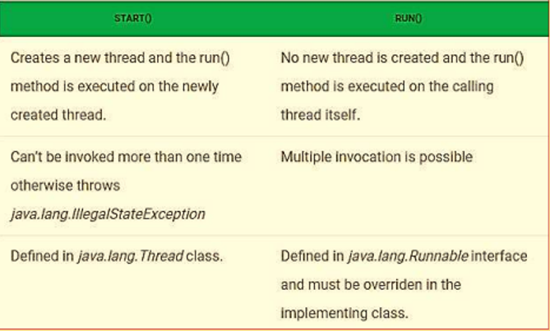

Slide 19
Implementing Runnable interface
The Runnable interface should be implemented by any class whose instances are intended to be executed by a thread.
Runnable interface have only one method named run().
public void run() - used to perform action for a thread.

Slide 20
Steps to create a new Thread using Runnable
Create a Runnable implementer and implement run() method.
Instantiate Thread class and pass the implementer to the Thread, Thread has a constructor which accepts Runnable instance.
Invoke start() of Thread instance, start internally calls run() of the implementer. Invoking start(), creates a new Thread which executes the code written in run().

Slide 21
Eg:
class Multi3 implements Runnable{
public void run(){
System.out.println("thread is running...");
}
public static void main(String args[]){
Multi3 m1=new Multi3(); //object of implementer created
Thread t1 =new Thread(m1); // Using the constructor Thread(Runnable r)
t1.start();
}
}

Slide 22
Creating Multiple Threads
class ThreadA extends Thread
{
public void run()
{
for(int i=1;i<=5;i++)
{
System.out.println("ThreadA i="+(1*i));
}
System.out.println("Exiting ThreadA");
}
}

Slide 23
class ThreadB extends Thread
{
public void run()
{
for(int j=1;j<=5;j++)
{
System.out.println("ThreadB j="+(2*j));
}
System.out.println("Exiting ThreadB");
}
}

Slide 24
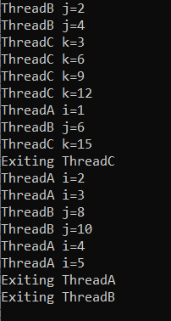
class ThreadC extends Thread{
public void run() {
for(int k=1;k<=5;k++){
System.out.println("ThreadC k="+(3*k));
}
System.out.println("Exiting ThreadC");
}}
class MultiThreadDemo{
public static void main(String args[]){
ThreadA t1= new ThreadA();
ThreadB t2= new ThreadB();
ThreadC t3= new ThreadC();
t1.start();
t2.start();
t3.start();
} }

Slide 25
Thread Synchronization
When we start two or more threads within a program, there may be a situation when multiple threads try to access the same resource and finally they can produce unforeseen result due to concurrency issues.
Synchronization in java is the capability of controlling the access of multiple threads to any shared resource.
For example, if multiple threads try to write within a same file then they may corrupt the data because one of the threads can override data or while one thread is opening the same file at the same time another thread might be closing the same file.

Slide 26
So there is a need to synchronize the action of multiple threads and make sure that only one thread can access the resource at a given point in time.
General form of the synchronized statement :
synchronized(object identifier)
{ // Access shared variables and other shared resources
}

Slide 27
Understanding the problem without Synchronization
In this example, we are not using synchronization and creating multiple threads that are accessing display method and produce the random output.
The object fnew of class First is shared by all the three running threads(ss,ss1 and ss2) to call the shared method (void display).Hence the result is non synchronized and such condition is called race condition.

Slide 28
class First{
public void display(String msg) {
System.out.print("["+msg);
try {
Thread.sleep(1000);
}
catch(InterruptedException e) {
e.printStackTrace();
}
System.out.println("]");
}}
class Second extends Thread {
String msg;
First fobj;
Second (First fp,String str) {
fobj = fp;
msg= str;
start();
}
public void run() {
fobj.display(msg);
} }
public class notSync{
public static void main (String[] args){
First fnew = new First();
Second ss = new Second(fnew,"welcome");
Second ss1= new Second(fnew,"new");
Second ss2= new Second(fnew, "programmer");
} }

Slide 29
Output
[welcome[programmer[new]
]
]

Slide 30
Synchronized Keyword
To synchronize above program, we must synchronize access to the shared display() method, making it available to only one thread at a time. This is done by using keyword synchronized with display() method.
With a synchronized method, the lock is obtained for the duration of the entire method.
So if you want to lock the whole object, use a synchronized method
synchronized void display (String msg)
eg: implementation of synchronized method

Slide 31
class First{
synchronized public void display(String msg) {
System.out.print("["+msg);
try {
Thread.sleep(500);
}
catch(InterruptedException e) {
e.printStackTrace();
}
System.out.println("]");
}}

Slide 32
class Second extends Thread {
String msg;
First fobj;
Second (First fp,String str) {
fobj = fp;
msg= str;
start();
}
public void run() {
fobj.display(msg);
} }

Slide 33
public class MyThreadDemo
{
public static void main (String[] args)
{
First fnew = new First();
Second ss = new Second(fnew,"welcome");
Second ss1= new Second(fnew,"new");
Second ss2= new Second(fnew, "programmer");
} }
Output
[welcome]
[new]
[programmer]

Slide 34
Using Synchronized block
If we want to synchronize access to an object of a class or only a part of a method to be synchronized then we can use synchronized block for it.
It is capable to make any part of the object and method synchronized.
With synchronized blocks we can specify exactly when the lock is needed. If you want to keep other parts of the object accessible to other threads, use synchronized block.
Eg:
In this example, we are using synchronized block that will make the display method available for single thread at a time.

Slide 35
class First{
public void display(String msg) {
System.out.print("["+msg);
try {
Thread.sleep(1000);
}
catch(InterruptedException e) {
e.printStackTrace();
}
System.out.println("]");
}}

Slide 36
class Second extends Thread {
String msg;
First fobj;
Second (First fp,String str) {
fobj = fp;
msg= str;
start();
}
public void run() {
synchronized(fobj)//sychronized block
{
fobj.display(msg);
} }}

Slide 37
public class SyncBlock
{
public static void main (String[] args)
{
First fnew = new First();
Second ss = new Second(fnew,"welcome");
Second ss1= new Second(fnew,"new");
Second ss2= new Second(fnew, "programmer");
} }
Output
[welcome]
[new]
[programmer]

Slide 38
In Java, synchronized keyword causes a performance cost.
A synchronized method in Java is very slow and can degrade performance.
So we must use synchronization keyword in java when it is necessary else, we should use Java synchronized block that is used for synchronizing critical section only.

Slide 39
Thread suspend() method
The suspend() method of thread class puts the thread from running to waiting state.
This method is used if you want to stop the thread execution and start it again when a certain event occurs.
This method allows a thread to temporarily cease execution.
The suspended thread can be resumed using the resume() method.
Syntax
public final void suspend()

Slide 40
Thread resume() method
• The resume() method of thread class is only used with suspend() method.
This method is used to resume a thread which was suspended using suspend() method.
This method allows the suspended thread to start again.
Syntax
public final void resume()

Slide 41
Thread stop() method
•The stop() method of thread class terminates the thread execution.
Once a thread is stopped, it cannot be restarted by start() method.
Syntax
public final void stop()
public final void stop(Throwable obj)

